Slide 1

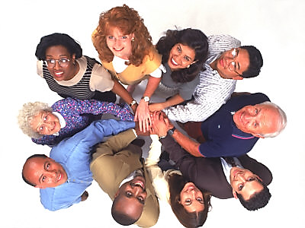

Slide 2

With the parts of the human body you have learned a long time and some of them know by heart. Check your knowledge! Name parts of the human body!

Slide 3
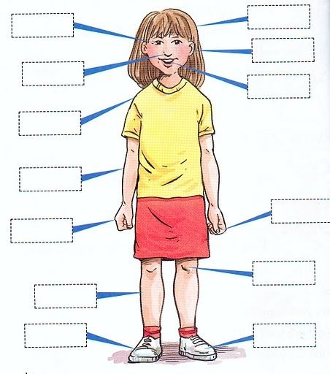
head
eye
ear
nose
mouth
shoulder
arm
finger
hand
knee
leg
foot
Toe

Slide 4
It's easy? Then one more exercise!

Slide 5
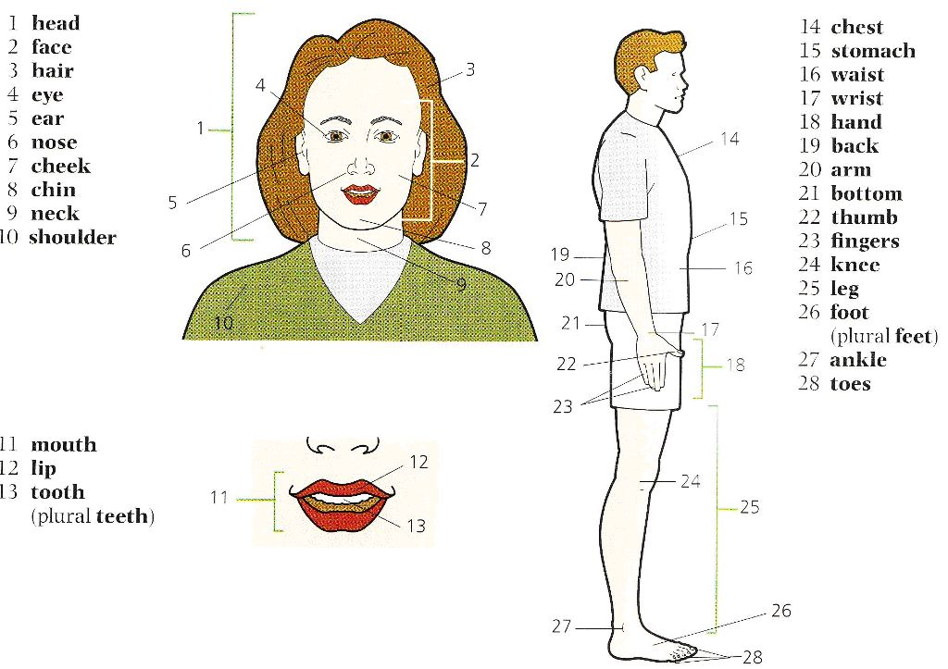
Hair
Eye
Head
Chest
Face
Ear
Stomach
Cheek
Back
Nose
Chin
Waist
Hand
Neck
Buttock
Wrist
Shoulder
Thumb
arm
Fingers
Lip
Leg
Mouth
Knee
Teeth
Ankle
Foot
Toes

Slide 6
See new unfamiliar words? Go back and write them down!

Slide 7

Answer the following questions:
What color is your hair?
Are your hair short or long?
What color are your eyes?
Is your face round or oval?
Are your cheeks rosy or pale?
Do you have healthy teeth?

Slide 8
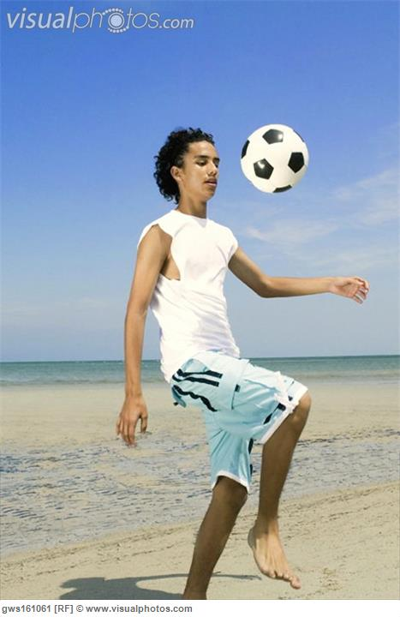
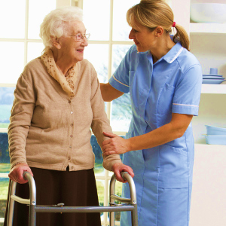
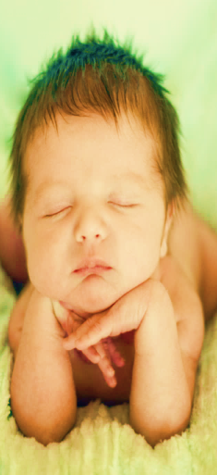
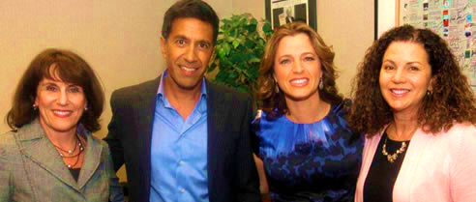
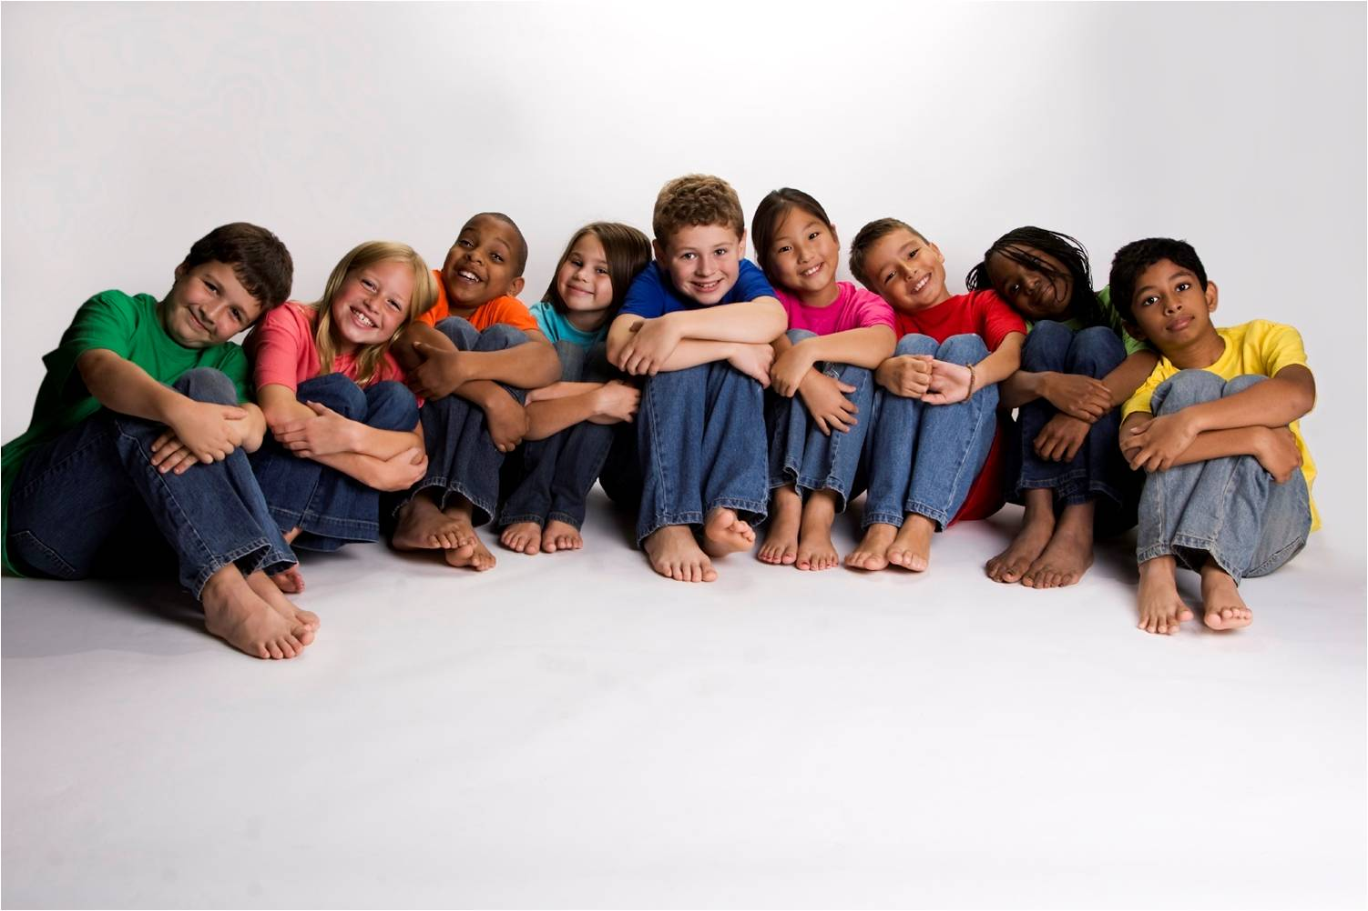
Age
Young
Teen-ager
(13-19 years old)
Elderly
Old
Middle-aged
Around 25 to 50 years old
young

Slide 9
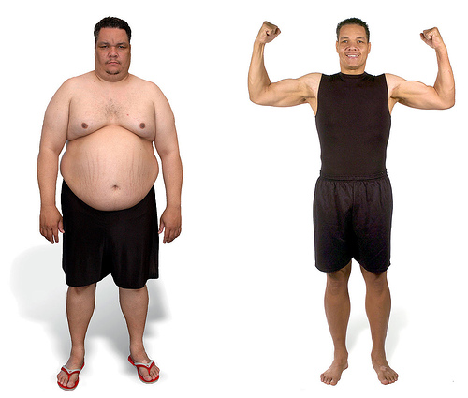
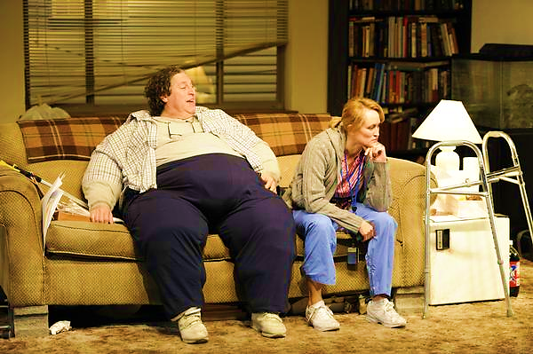
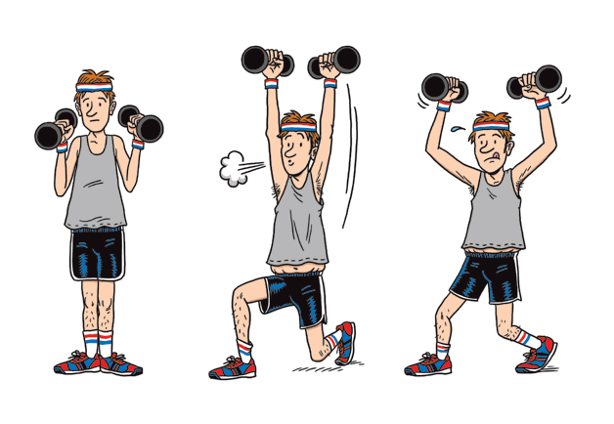
BUILD
Fat
Obese
Overweight
Thin Skinny
Slim
Slender
Medium-build
Of average build
Well-build
Broad-shouldered
Muscular

Slide 10
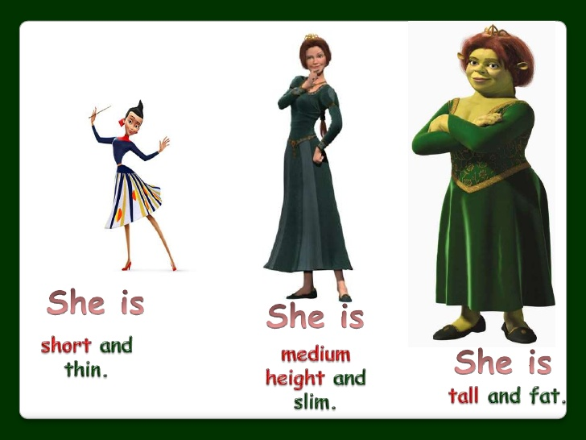
HEIGHT

Slide 11
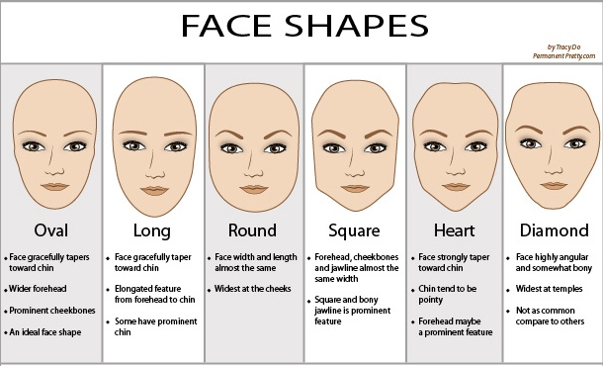
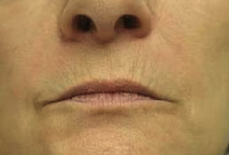
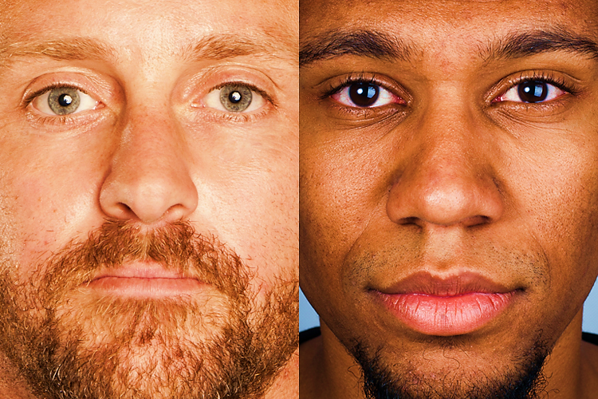
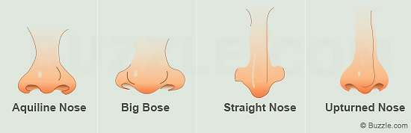
Thin lips
Thick lips

Slide 12
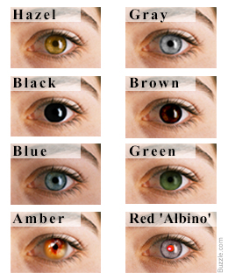
Eye colors

Slide 13
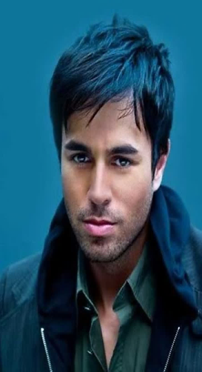
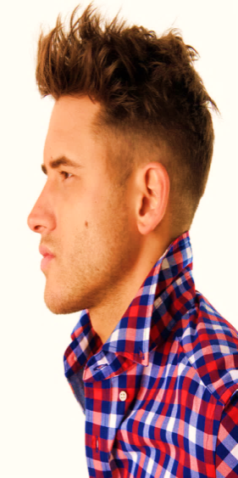
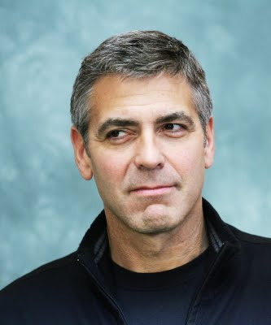
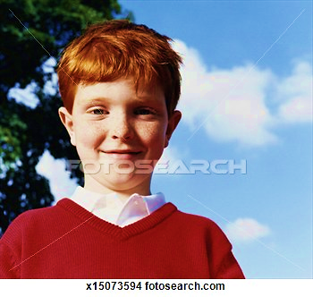
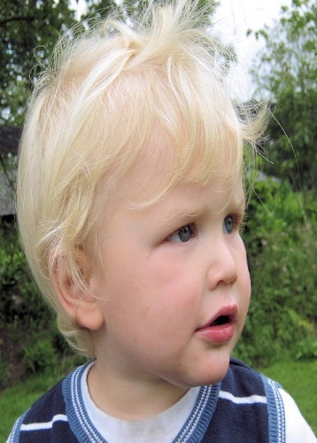

Hair color
Black
Brown
Redhead
Blonde
Gray
White

Slide 14
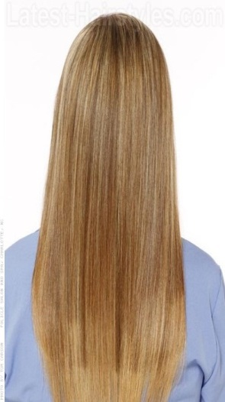
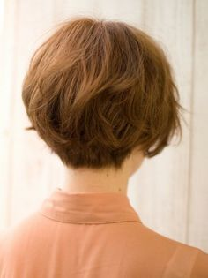
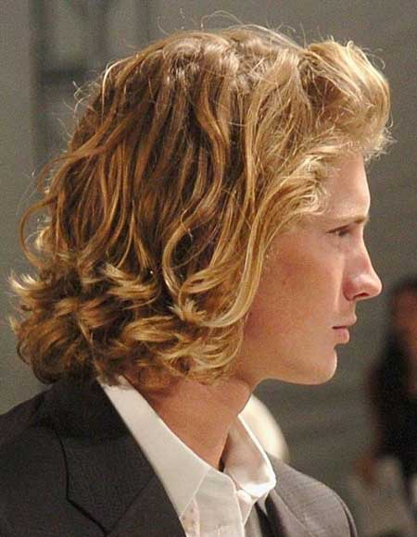
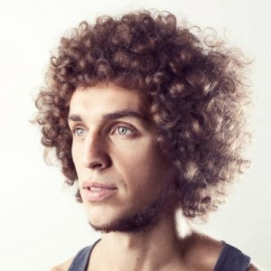
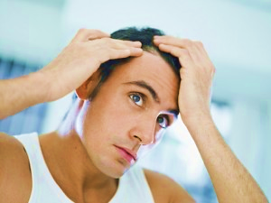
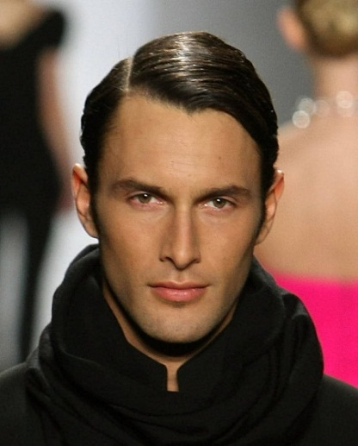
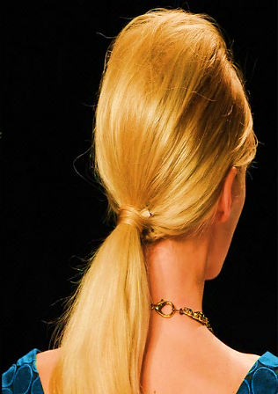
HAIRSTYLE
Long and
Straight
Short
Curly
Wavy
Pony-tail
Neat
Balding/Thinning/Receding

Slide 15
Sentences
He has curly hair.
curly he hair has
is bald he
long blonde she hair has
short black he hair has
brown short has she hair
grey hair long she has
He is bald.
She has long blonde hair.
He has short black hair.
She has short brown hair.
She has long grey hair.

Slide 16
Translate the text
What do you know about your body? The human body is very beautiful. It consists of arms, legs, a trunk, a head, a neck and so on. The eyes help us to see, the ears help us to hear, the mouth and lips help us to speak and eat food.
All people have different faces. There are two eyes, a nose, a mouth on our face. We have hair, a neck, two shoulders, ten fingers, ten toes, ten nails, two feet, two knees, two cheeks, two eyebrows, a forehead, a chin.

Slide 17
Everybody has own skin. It comes in many colors. People who live in Africa have brown or black skin. People who live in Europe have white skin.
Our hair can be straight or curly, long, short, dark, blonde, gray.
There are two kidneys, two lungs, a heart, a stomach, a liver and other organs in humans’ bodies.
There are 32 teeth and one tongue in our mouth. Some people (kids and adults) lose some of their teeth, so they don't have 32 teeth.

Slide 18
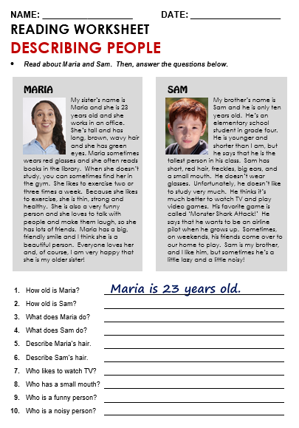

Slide 19
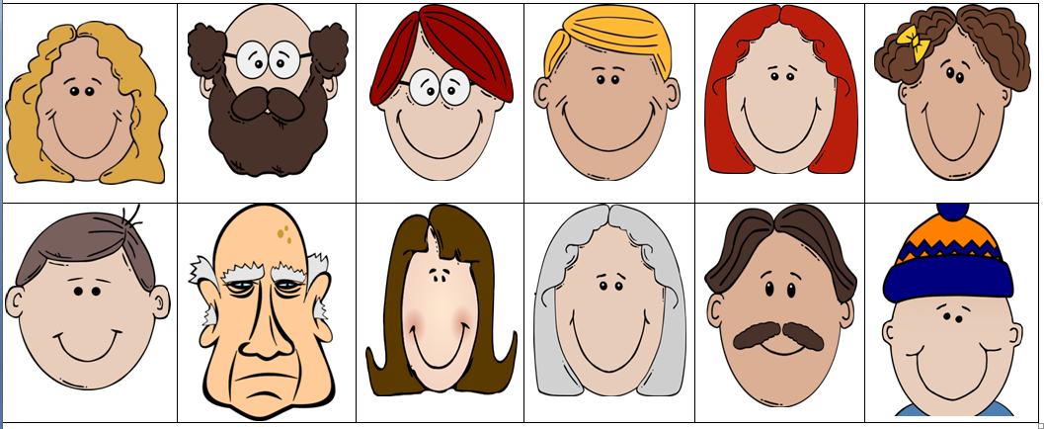
Now write sentences in your book describing each of the people.
If you finish then write sentences describing 2 people you know.

Slide 20

