Slide 1

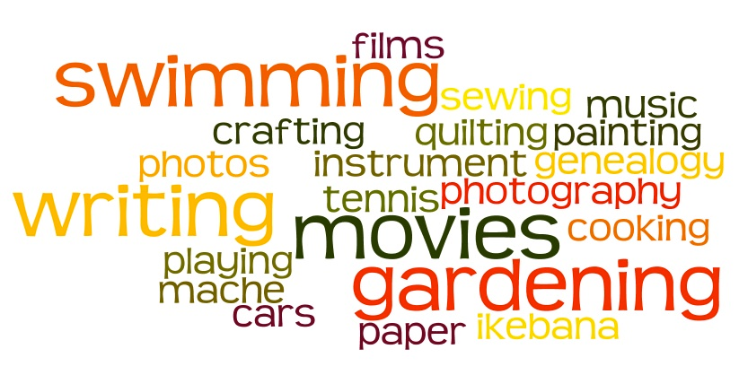
Leisure time.
Hobbies and activities.

Slide 2

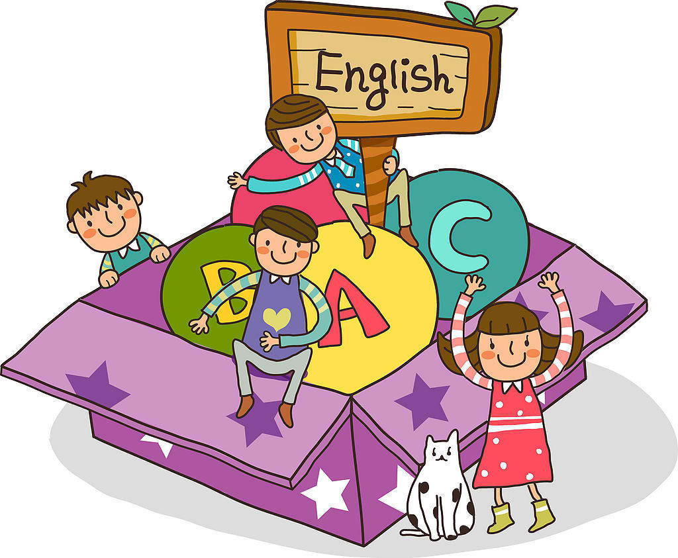
Leisure time.
Hobbies and activities.

Slide 3


What does it mean?
Leisure time Spare time
Free time

Slide 4
What is a hobby?
What kind of leisure activities do you know?
What do you prefer to do in your free time?
Are hobbies the same in different countries?

Slide 5
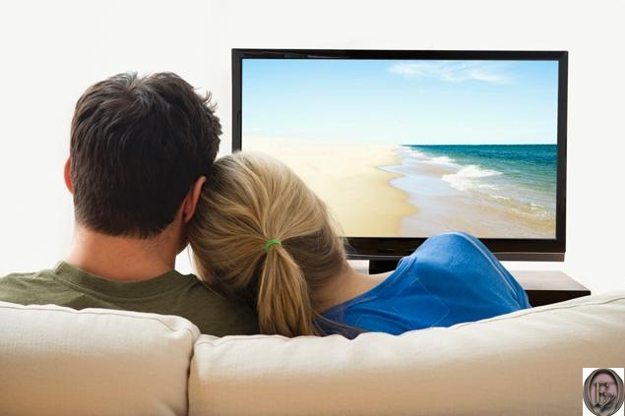
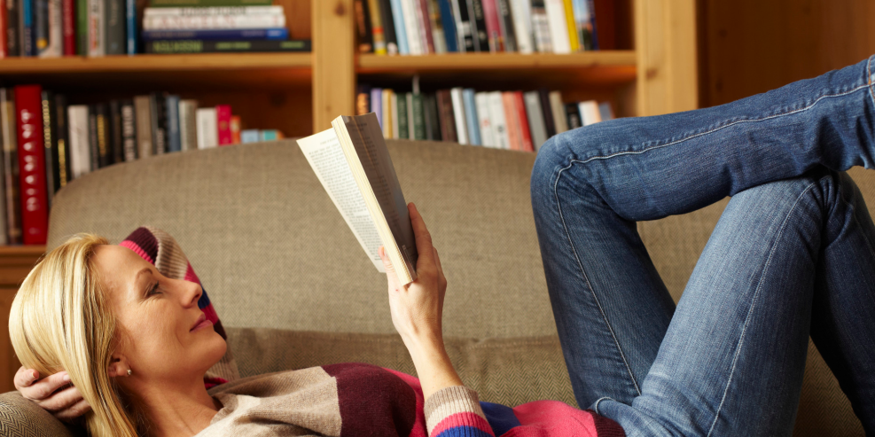
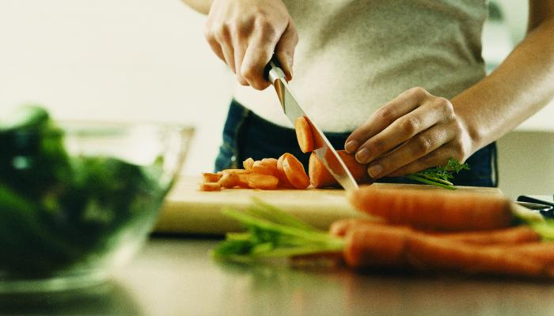
watching TV
reading
cooking

Slide 6
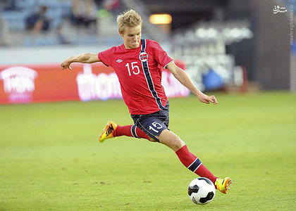
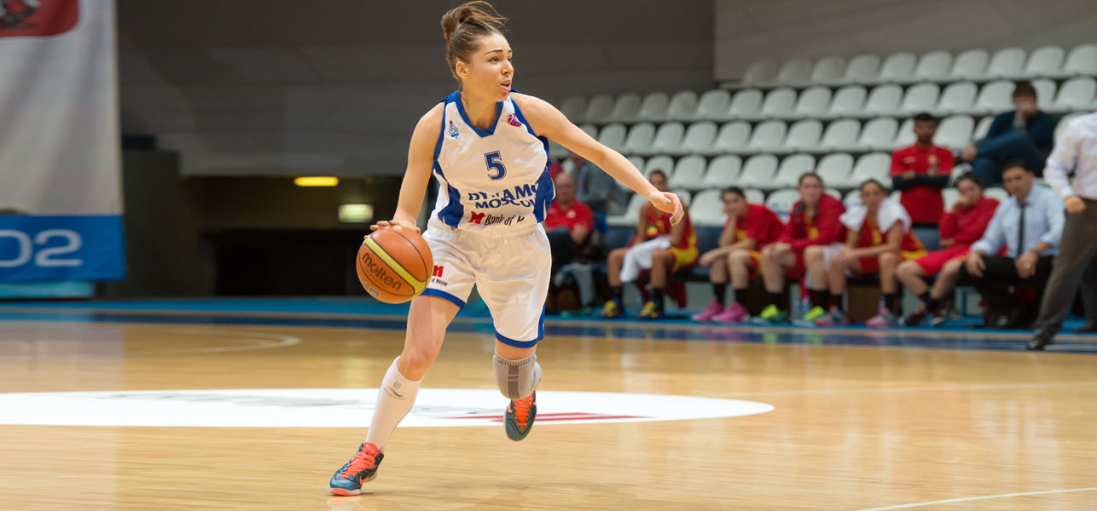
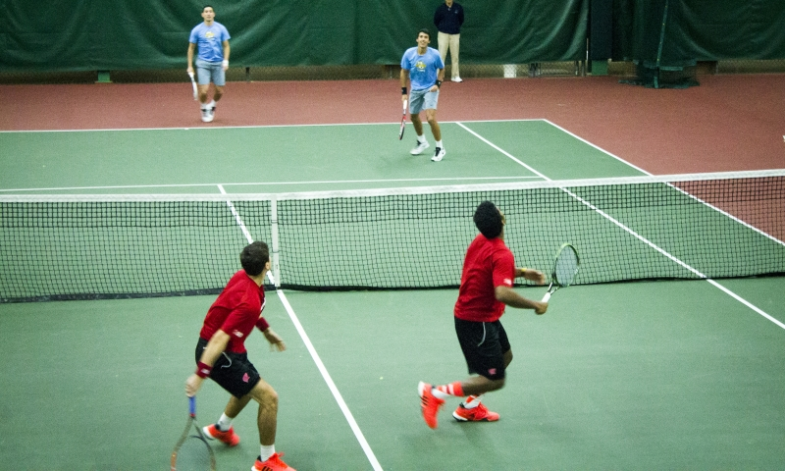
playing
football
playing basketball
playing tennis

Slide 7
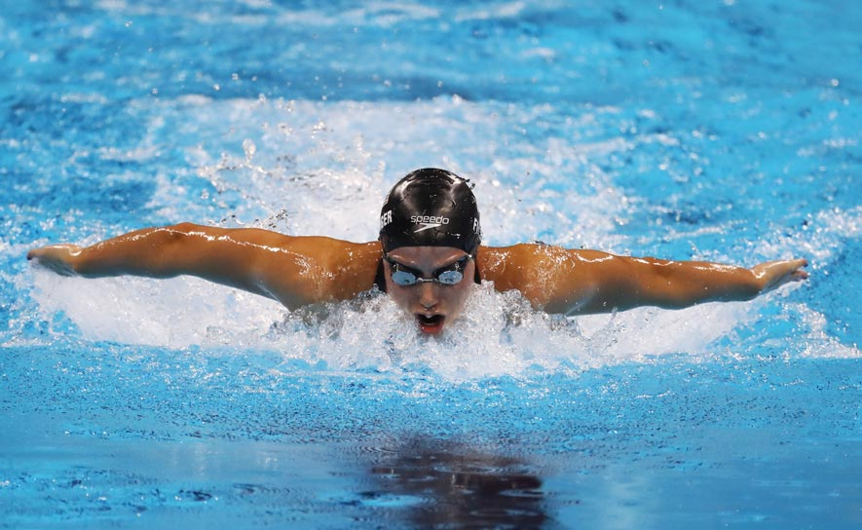
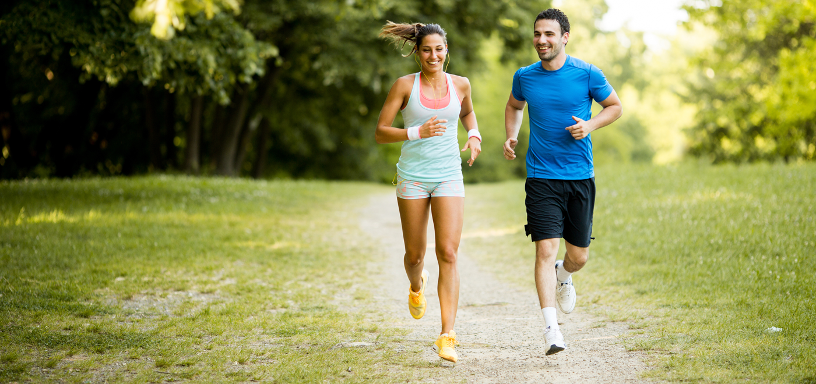
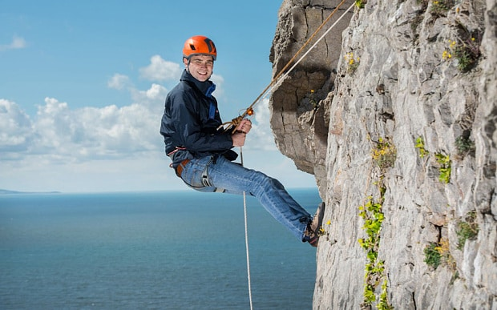
going swimming
going jogging
going climbing

Slide 8
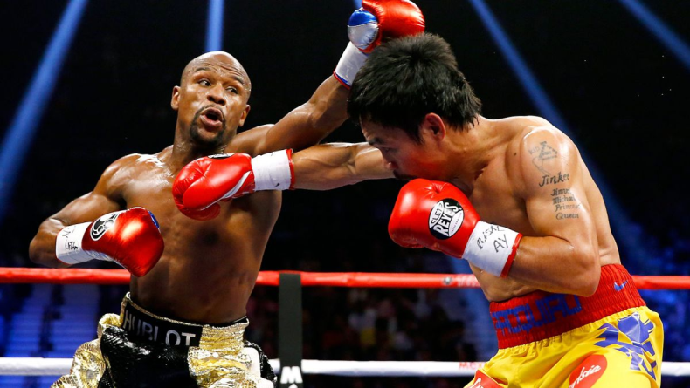
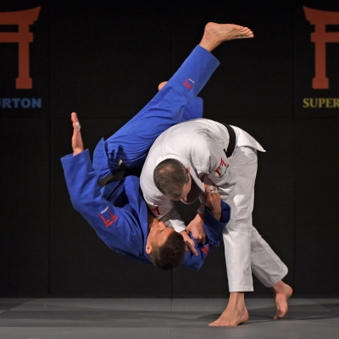
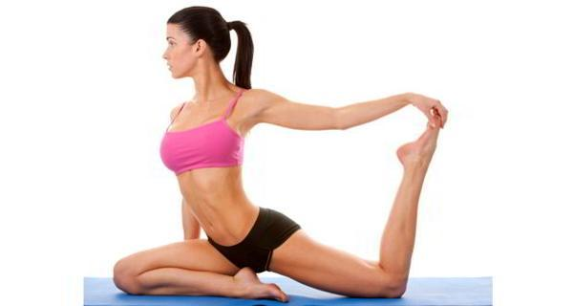
doing boxing
doing judo
doing yoga

Slide 9
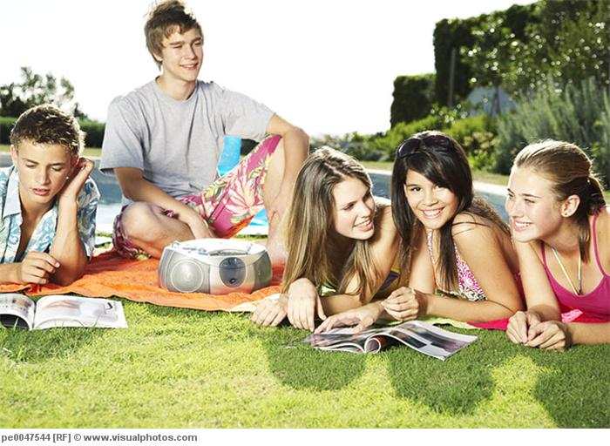
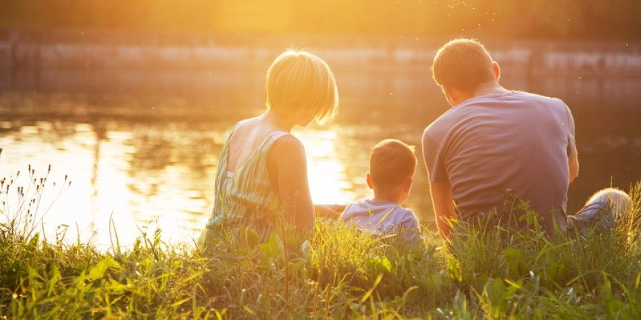
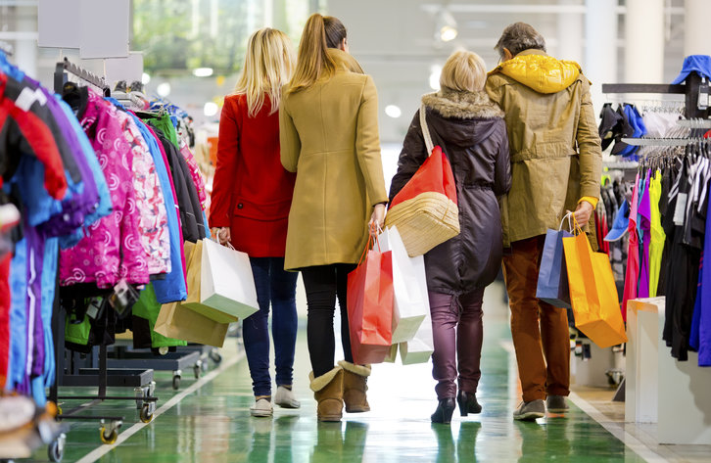
hanging out
with friends
relaxing with
family
going shopping

Slide 10
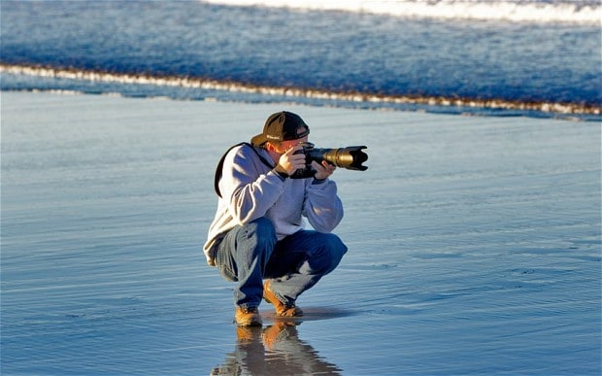
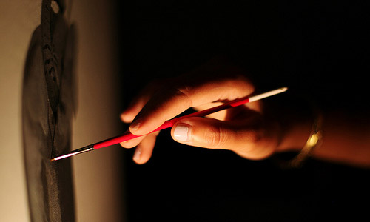

taking photos
painting
writing stories/
a blog

Slide 11

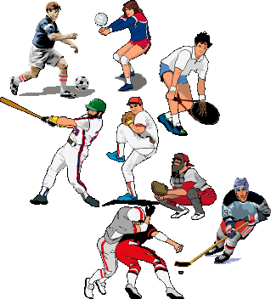

Doing sports
Many people, especially those who take care about their health, are doing different kind of sports: playing games, jogging, skating and others.

Slide 12
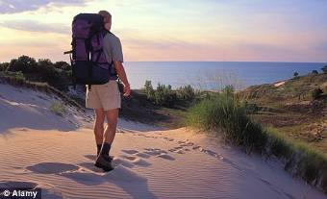
Travelling
Travelling is one of the most interesting hobbies for both young and senior people. Its a good opportunity to get acquainted to new places and new people.

Slide 13
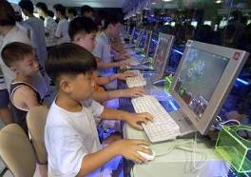
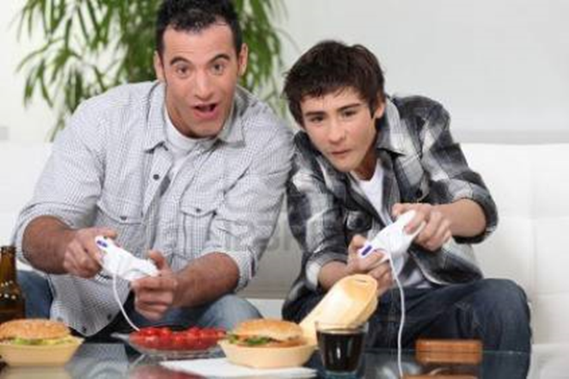
Playing computer games
Without a doubt, nowadays there are a lot of people both kids and adults enjoying this way of spending free time.

Slide 14

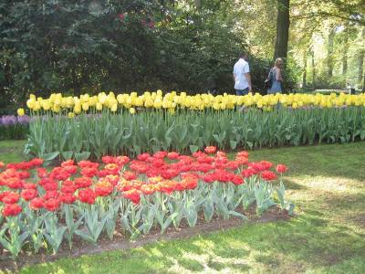
Growing flowers
It’s really an art to grow flowers, trees and bushes by your own hands for keeping your garden beautiful.

Slide 15
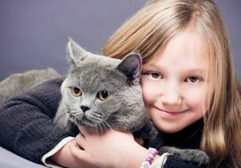

Keeping pets
It’s a nice feeling to take care about our small friends who really need it.

Slide 16
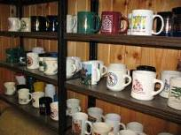
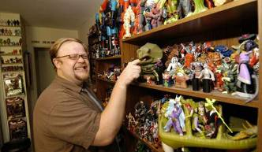

Collecting things
People can collect different things- from small things to huge ones

Slide 17
1. How do you usually spend your free time?
(If I have free time, I usually…)
2. What do you dislike doing in you free time?
( I dislike…)
3. How often do you watch TV?
(… hours a day.)
4. Do you like going to the cinema or to the theatre?
(I prefer… )
5. Who is you best friend?
6. Can you describe his/her appearance?
7. Do you spend you free time together?

Slide 18

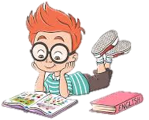
Learn new words
Lesson 25 Ex-1,2

