Slide 1

My working day

Slide 2
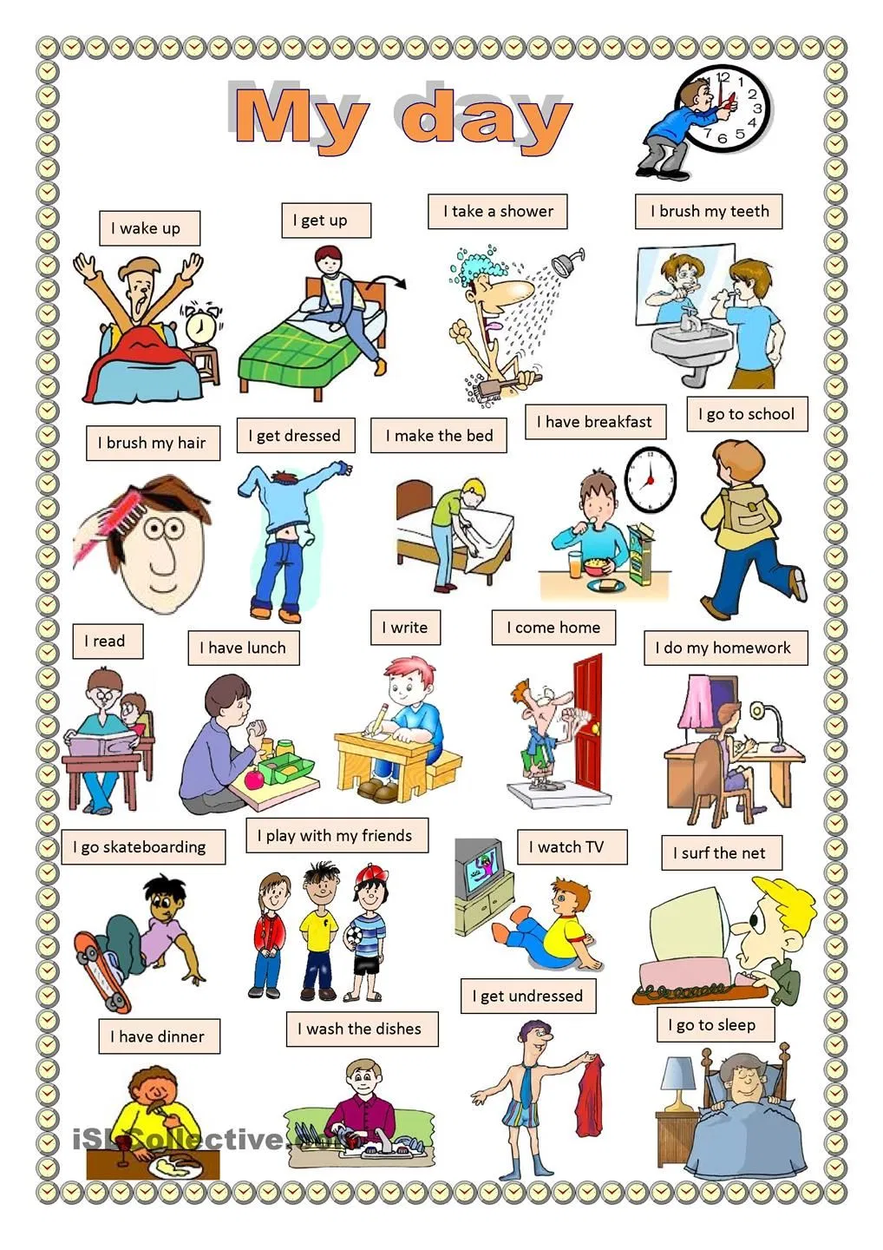

Slide 3


Match actions with text
have my dinner
get up
do homework
wash
have break­fast
go to school
watch TV
go to bed
My working day.
I usually ……..at 7 o’clock. I …… my hands and face. I usually …………….at 7.30. Then I …………. I have 6 lessons every day. I have Russian, English, Maths, History, Literature, Music, Art and Physical Education. At 2 o’clock I……............... . Then I……........... In the evening I read books, ………..and help my mother about the house. At 10 o’clock I……….. .

Slide 4

to have a shower
to dress
to go home
to do homework
to go for a walk
принимать душ
одеваться
идти домой
делать домашнее задание
идти гулять

Slide 5
обедать
to have dinner
ложиться спать
to go to bed
to drive a car
to brush teeth
to wash
водить машину
чистить зубы
умываться

Slide 6

Answer the questions
1. When do you usually get up on week days?
2. What do you do when you have got up?
3. What do you prefer for breakfasts?
4. How many lessons do you have every day?
4. What do you do when you have some spare time?
6. When do you usually go to bed?

Slide 7
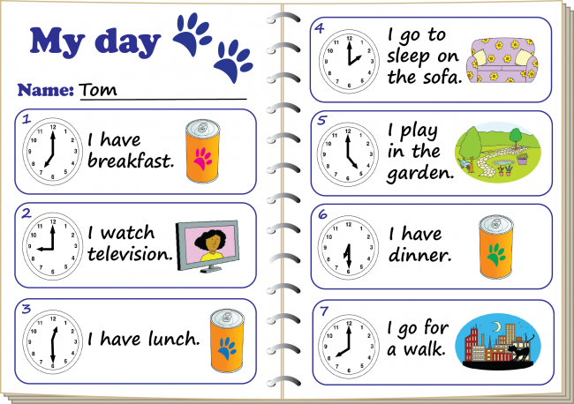

Slide 8

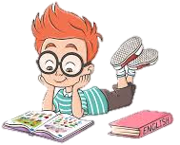
Learn new words
Tell about Your working day

