Slide 1


ЖИЛИЩНО-БЫТОВЫЕ УСЛОВИЯ ЖИЗНИ
HOME SWEET HOME
Some people live in houses
But most people live in flats

Slide 2
VOCABULARY
Block of flats – многоэтажный дом.
to gather – собираться.
to lead – вести, руководить.
In the middle – в середине.
In the corner – в углу.
Near – близко.
Refrigerator – холодильник.
Fresh – свежий.
Keep – держать, хранить.
Running water – водопроводная вода.
Central heating – центральное отопление.
to invite – приглашать. He invited me to the theatre.
House-warming – новоселье.
Above – над.
Ceiling – потолок.

Slide 3
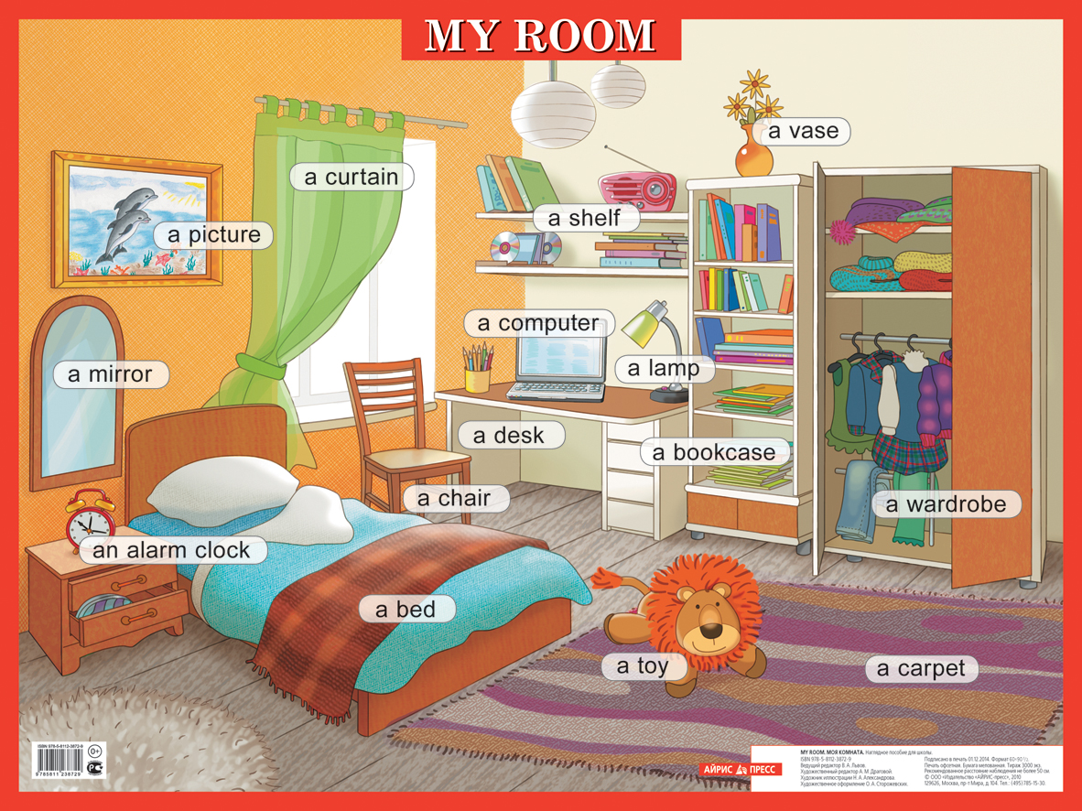

Slide 4

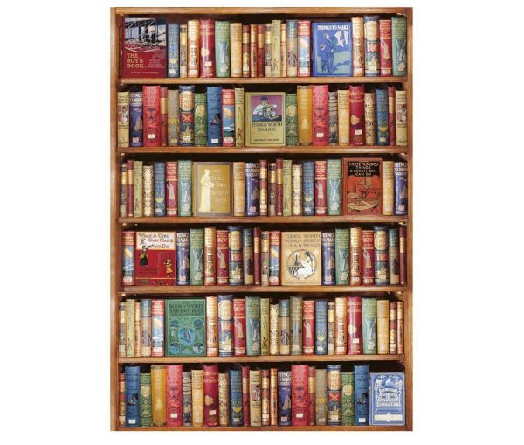
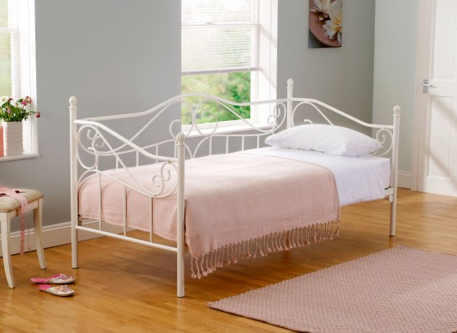

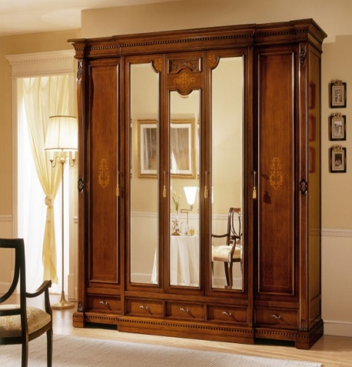
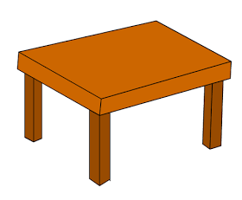
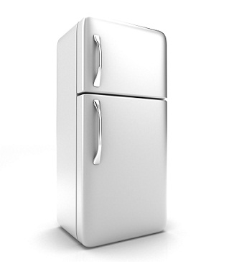
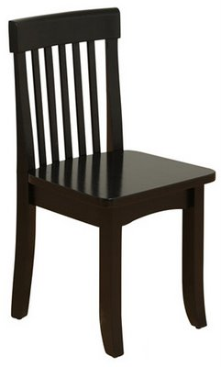

a bookcase
a bed
a sofa
a table
a fridge
an armchair
a wardrobe
a carpet
a chair

Slide 5
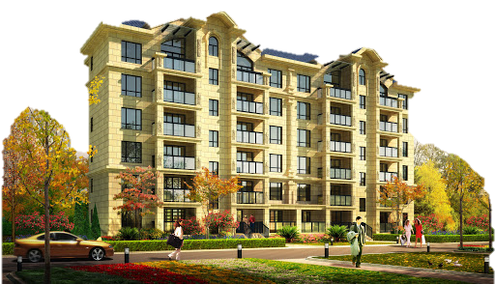
We live in Moscow in Minskaya Street in a new block of flats. Our flat is large and comfortable. It is a four-room flat. We got it two years ago. We live on the fifth floor. There is a shop on the ground floor. There is a lift in our block of flats.

Slide 6
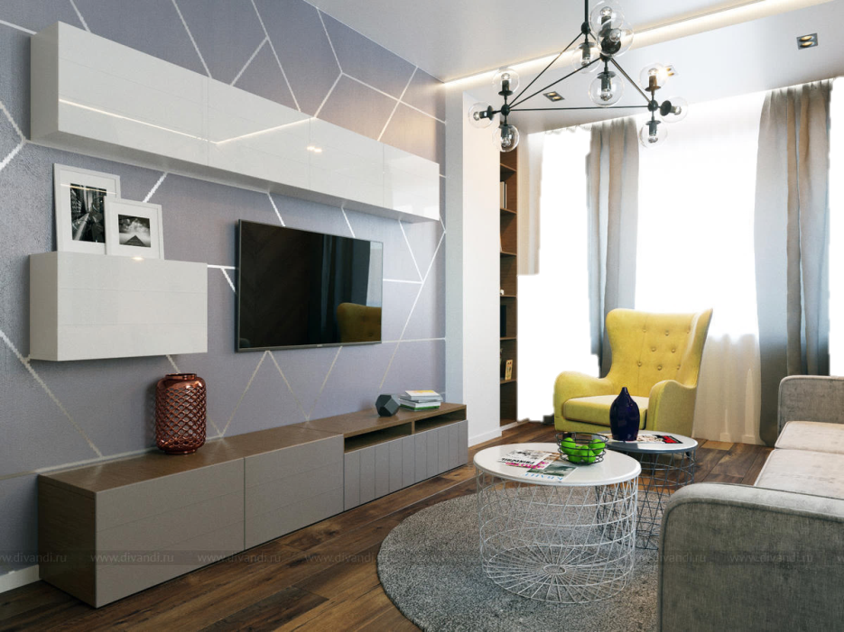
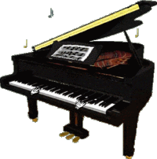
Let’s have a look at our flat. Though there are four rooms in our flat we like our living-room best of all because in the evening we gather there to have tea, watch TV, talk and rest. The living-room is large. There are two windows and a door in it. The windows face the street. The door leads to my grandparents’ bedroom. There is a table and some chairs in the middle of the room. There is a sofa near the window. The TV is in the corner. There are some arm-chairs and a piano in the living-room. My sister plays the piano. You can see four bookshelves on the wall. The ceiling is high.

Slide 7
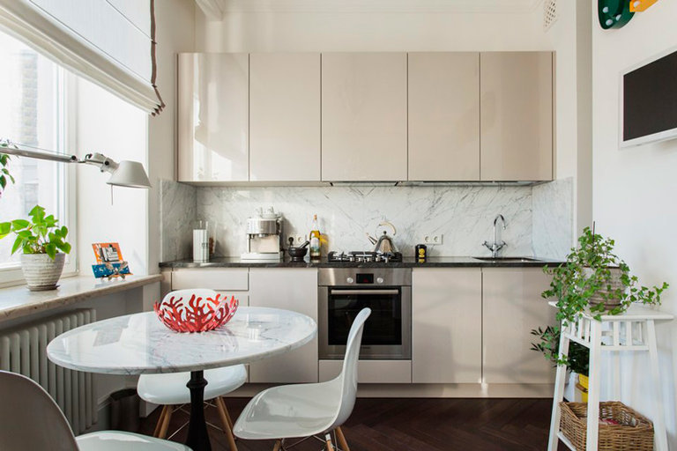
In the morning we have breakfast in the kitchen. It is large and light. The table is near the window. The refrigerator is in the corner. It keeps all the food fresh. It doesn’t use much electricity. The gas-stove is opposite the fridge. There is always running hot and cold water and central heating in our block of flats. When we got our flat we invited all our friends for the house-warming. It was a joyful party.

Slide 8
СООТНЕСИТЕ СЛОВА.
central heating
on the ground floor
a joyful party
doesn’t use much electricity
a four-room flat
a new block of flats
keeps the food fresh
house-warming
новый многоэтажный дом
четырёхкомнатная квартира
на первом этаже
весёлая вечеринка
сохраняет пищу свежей
не потребляет много электричества
центральное отопление
новоселье

Slide 9

Lesson 22
Learn new words
Watch the video
(https://www.youtube.com/watch?v=bby09gf1K-c)
Ex.4 P.69

